Slide 1
Your webinar will begin shortly!

Slide 2


Developing Independent Learners webinar 5
Met

Slide 3
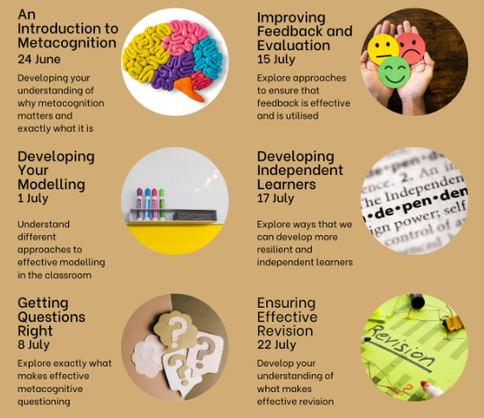

Slide 4

A Little Ask...
Share comments and photos across social media!
X: @MrMetacognition
BlueSky: mrmetacognition.bsky.social
LinkedIn: Nathan Burns
Pay as you feel/can

Slide 5
Contracting Sessions
Note down questions so that you don't forget them.
Opportunity to record them on the post-session survey.
Reach out to me through my SM channels
Email me: nathan@mrmetacognition.com OR mrmetacognition@gmail.com

Slide 7
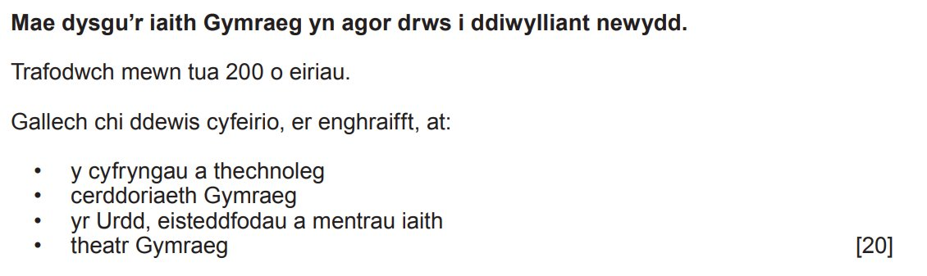

Slide 8
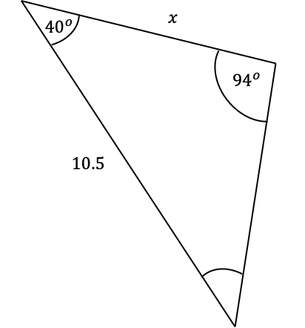

Slide 9
Session Aims
Review the importance of metacognition in developing resilient and independent learners
Establish a range of approaches that we can use to develop independence and resilience

Slide 10
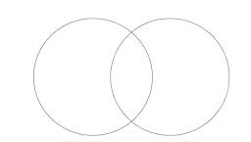
Write...
What characteristics do independent & resilient learners have?

Slide 11
Effective Independent Learners
An effective independent learner:
Knows exactly what work they need to focus on
Has strategies to turn to when they are struggling
Knows when they need to ask for further support
Understands effective ways to revise
Has a set of effective reflection strategies
Has appropriate planning techniques
Fully considers the task at hand

Slide 12
Resilient Learners
A resilient learner:
Doesn't instantly give up
Has a range of strategies for when they are struggling
Knows how to regulate their emotions
Knows which resources to turn to for support
Knows how to communicate what they are struggling with
Can prioritise long-term, over short-term, gain

Slide 13
Developing Independent & Resilient Learners
There are a number of ways in which we can develop independent and resilient learners, from the tasks that we set them to the way we communicate expectations with parents.
Focus today is on a set of metacognitive strategies, which support the metacognitive abilities of students, and hence improve the effectiveness of their independent learning.

Slide 14
The Strategies
For each strategy, the what and the why will be given.
Examples will then be considered for each strategy, that are context specific.

Slide 15
Knowledge of Grid
What?
Knowledge of grid is a planning tool to get students to think about the fundamentals of any cognitive activity:
  Knowledge of task
  Knowledge of self
  Knowledge of strategies
Why?
Student forced to attend to these factors
Places emphasis and priority on these areas (and moves it away from just doing the task)
Scaffolds an approach to a (complex) task

Slide 16
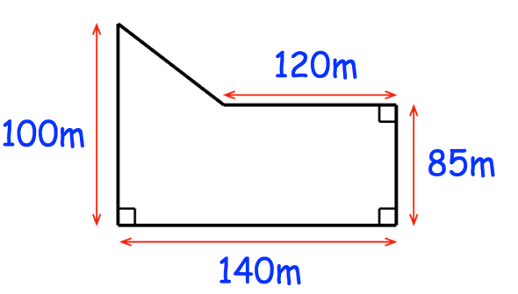
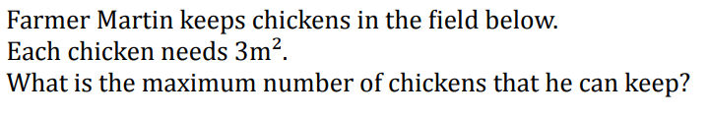
Example
Knowledge of Task | Knowledge of Self | Knowledge of Strategies
Finding the maximum chicken that can be in there
Whole number
Round down
Show method
Not confident on method to find area
Know need to divide area by chickens
Confident I need to round down
Area – split into two shapes or three.
Not clear on area of a trapezium
Do know area of triangle – slower but more confident
Corbett Maths

Slide 17
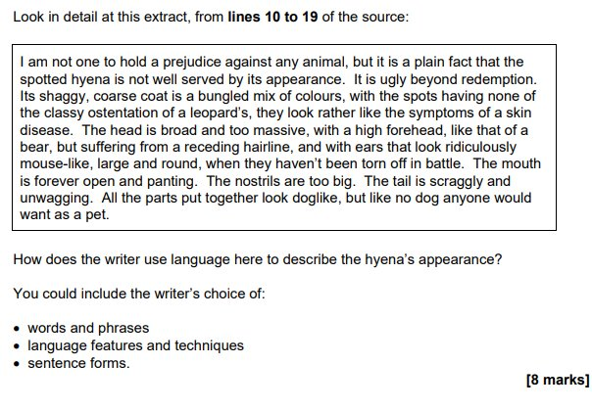
Example
Knowledge of Task | Knowledge of Self | Knowledge of Strategies
Only in relation to hyena and appearance
8 marks, so 8 points.
2 for each category and explain them (Is this enough)?
Not limited by this, so maybe make 2 other points?
Can draw out examples from text - 'too big', 'scraggly'
Techniques include...
Sentence forms include...
What about..?
Work through each area they've mentioned, 2 points each.
Then my further 2 points.
Need to quote from text (but not too long)
AQA

Slide 18
Example
Design a training program for a cross-country runner, who is looking to run a marathon, in 6 months
Knowledge of Task | Knowledge of Self | Knowledge of Strategies
Needs to be a 6 month plan
Start level of fitness is high
Need to build up to 26.2 miles
Not sure what they are currently doing?
Clear on endpoint.
May want to include some sprints in there too
Different layout options
Different training pathways
May be able to give more than 1 option

Slide 19

Example
Knowledge of Task | Knowledge of Self | Knowledge of Strategies
Description only
5 marks – 5 points
Process description
Enters at the...
Then...
Leaves at...
Can I bullet point the response?
Otherwise in continuous prose.
Need to put stages in order
AQA

Slide 20
Example
Consider the benefits and drawbacks of using a 'dry run' for a newly develop computer program (5)
Knowledge of Task | Knowledge of Self | Knowledge of Strategies
Need to define
Need to provide at least 2 benefits and 2 drawbacks (5 marks, 1 for define, 2 for +, 2 for -)
+ Identify issues
+ Reduce costly changes later
Takes time
Financial cost
Start with define, then do the two + then two -
Or I could try to link them together, e.g. identify issues but this will cost more money to do

Slide 21
Goal Free Problems
What?
The removal of the question from a context problem, so students are left with multiple things that they could work out, and are not just limited by the question
Why?
Removes the barrier of a 'question'
Improves student confidence; show them what they can do
Removes limitation of absence, misunderstanding etc.

Slide 22
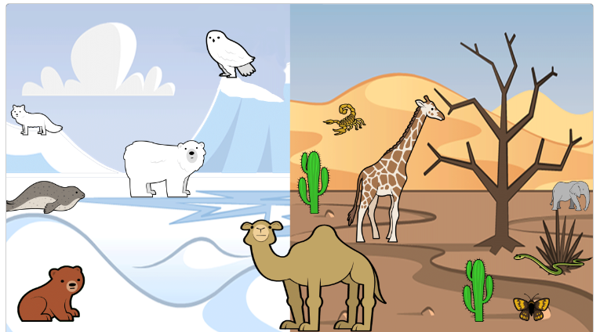
Example
What could a question be?
What can you deduce from the image?
What do you agree on? What do you disagree on?
What topic(s) may this link in to?
Describe the adaptions shown by 3 animals in this photo

Slide 23
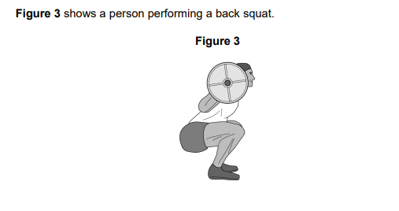
Example
What may the image be showing you?
What follow-up questions may be asked?
What might you suggest?

Slide 24
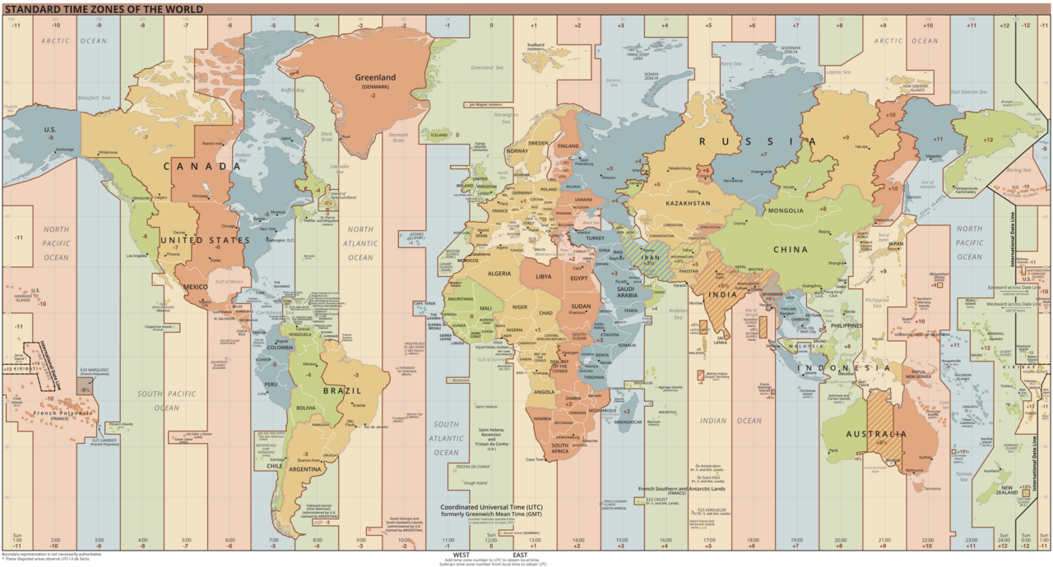
Example
What do you know?
What can you calculate?
Are you in agreement?
Wikipedia

Slide 25

Example
What do you know?
What ight the image tell us?
How does it connect with other learning?
What questions might we be asked?
Are you in agreement?
TES

Slide 26
Model Scaffold Use
What?
Scaffolds used to bridge gaps between current levels and desired level.
Focus here is on training students what scaffolds that they have available to them, how to use them and why they are helpful.
Why?
High quality feedback supports student in identifying and improving on target areas.
Improved independent learners

Slide 27
Example
For example...
Writing frame
Sentence starters
Key word bank
Knowledge organisers
Calculator ​
Model answers​
Calculation sheets​
Exemplars​
Textbooks/guides

Slide 28
Limited Questions
What?
Reduce the number of questions that students are allowed to ask.
OR
Limit questions to being metacognitively focused.
Can be during teacher modelling time or independent practice.
Why?
Students forced to consider what they actually need to know – Knowledge of Self.
Questions become more precise – Knowledge of Task/Strategies
Students develop independence as they look to next step, not final solution (planning/monitoring)

Slide 29
Example
How many dates do I need to include to get full marks? NOT. what do I need to do?
What is the next stage in this strategy? NOT. I don't know how this works.
Which planning method would you be using? NOT. How do I plan?
How much method do I need to show? NOT. Am I showing methods?

Slide 30
Teachers Work Harder, Students Don't?
Does implementing these strategies mean that teachers work harder, but students don't?
Teachers implement these strategies
Leading to...
  Student's independent work being more effective
  Students not instantly 'giving up'
  As...
  Resilience improves
  Student skill sets improve
  Students are more effective and efficient
So students are better able to take control of their learning

Slide 31

What's Next?
Share comments and photos across social media!
X: @MrMetacognition
BlueSky: mrmetacognition.bsky.social
LinkedIn: Nathan Burns
Pay as you feel/can
Survey

